Slide 1
Jersey Part 2
For RESTFul application
(additional: jdbc, web, jpa)
Author: Pavel Vrublevskij

Slide 2
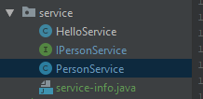
Create PersonService Class
@Service public class PersonService implements IPersonService { @Autowired private JdbcTemplate jtm; public List<Person> findAll() { String sql = "SELECT * FROM PERSON"; List<Person> persons = jtm.query(sql,
new BeanPropertyRowMapper(Person.class)); return persons; }
}
Put @Service top on Class
Write a code as example:

Slide 3

Create PersonController Class
@RestController public class PersonController { @Autowired private PersonService personService; @GET
@RequestMapping("/persons") public List<Person> findAll() { return personService.findAll(); } }
Put @RestController top on Class
Write a code as example:

Slide 4
Add dependency
<dependency> <groupId>org.springframework.boot</groupId> <artifactId>spring-boot-starter-web</artifactId> </dependency>

Slide 5
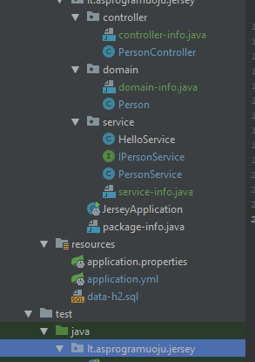
Project structure
<dependencies> <dependency> <groupId>org.springframework.boot</groupId> <artifactId>spring-boot-starter-jersey</artifactId> </dependency> <dependency> <groupId>org.springframework.boot</groupId> <artifactId>spring-boot-starter-web</artifactId> </dependency> <dependency> <groupId>org.springframework.boot</groupId> <artifactId>spring-boot-starter-data-jpa</artifactId> </dependency> <dependency> <groupId>org.springframework.boot</groupId> <artifactId>spring-boot-starter-jdbc</artifactId> </dependency> <!-- JDBC --> <dependency> <groupId>com.h2database</groupId> <artifactId>h2</artifactId> <version>1.4.197</version> <scope>runtime</scope> </dependency> <dependency> <groupId>org.springframework.boot</groupId> <artifactId>spring-boot-starter-test</artifactId> <scope>test</scope> </dependency> </dependencies> <build> <plugins> <plugin> <groupId>org.springframework.boot</groupId> <artifactId>spring-boot-maven-plugin</artifactId> </plugin> </plugins> </build>

Slide 6
Make test for your RestFul application

Slide 7

Create Test for Service
@RunWith(SpringRunner.class) @SpringBootTest(webEnvironment = SpringBootTest.WebEnvironment.RANDOM_PORT) public class JerseyApplicationTests { @Autowired private TestRestTemplate restTemplate; @Test public void hello() { ResponseEntity<String> entity = this.restTemplate.getForEntity("/hello", String.class); assertThat(entity.getStatusCode()).isEqualTo(HttpStatus.OK); assertThat(entity.getBody()).isEqualTo("Hello from Spring"); } }

Slide 8
Task
Rename Entity Person to Customer
Create more attribute data for Customer domain class, i.e. mobile_phone, city, etc.
Create City Entity and make association with Customer by Foreign Key
Create more Entities by screenshot on next slide

Slide 9
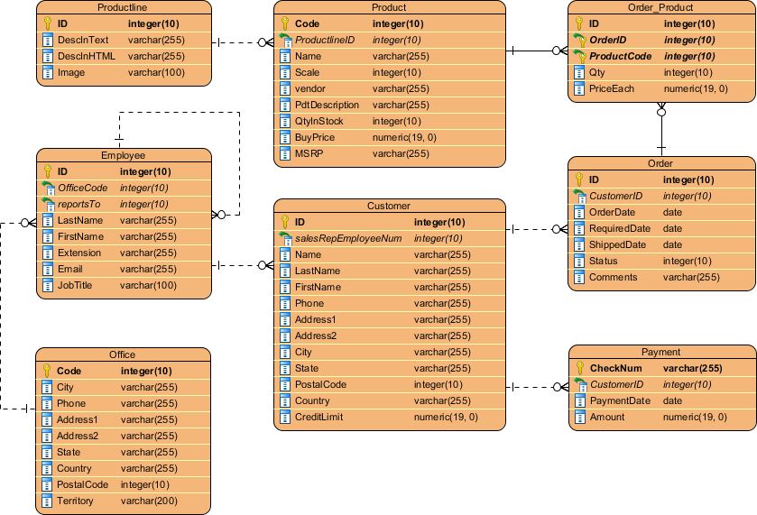
Create Entities by logical ER diagram below

Slide 10
http://zetcode.com/springboot/jersey/
http://zetcode.com/articles/springbootresth2/

